Slide 1
Chapters 1 & 2
Physics by HRK V1 5th Ed.
Topic nos. differ as the material is taken from an FoP by HRW 10th Ed. &
Physics for Scintists. & Engrs. By Serway & Jewett 9th Ed.
Measurement
&
Motion in One dimension
(Selected Topics)
By
Zuhoor Elahi

Slide 2
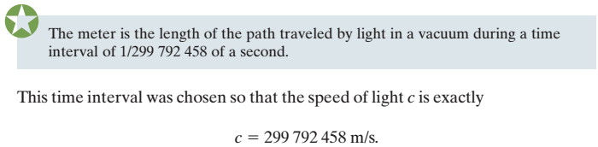


Measurement Standards
Length
Time
Mass
  The SI standard of mass is a cylinder of platinum and iridium (Fig. 1-3) that is kept at the International Bureau of Weights and Measures near Paris and assigned, by international agreement, a mass of 1 kilogram.

Slide 3
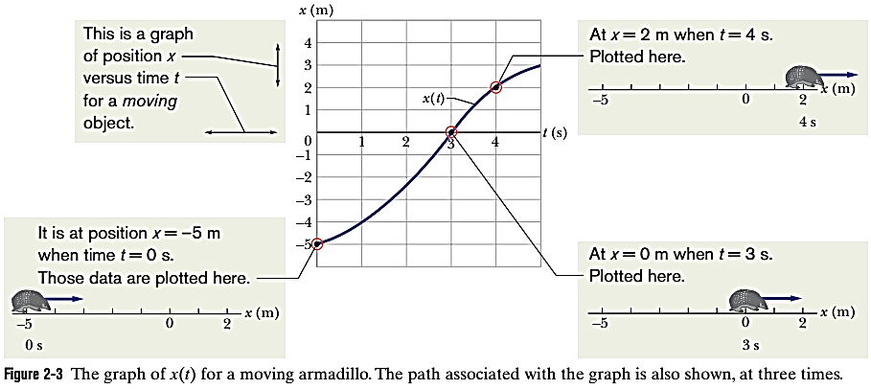
1-Dimensional Kinematics

Slide 4


1-Dimensional Kinematics

Slide 5

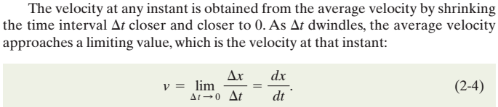

1-Dimensional Kinematics

Slide 6

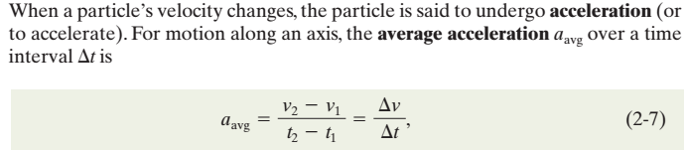

1-Dimensional Kinematics

Slide 7
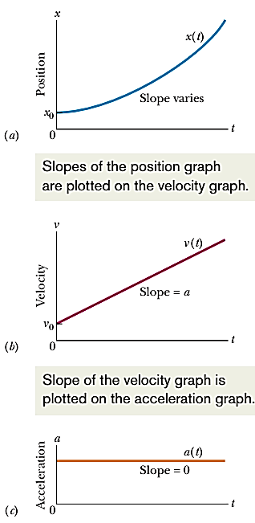
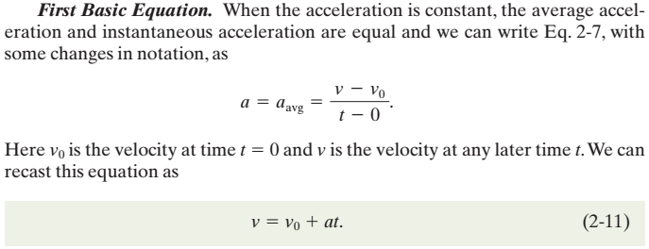
1-Dimensional Kinematics

Slide 8
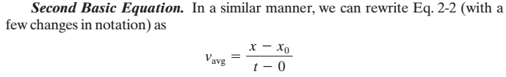
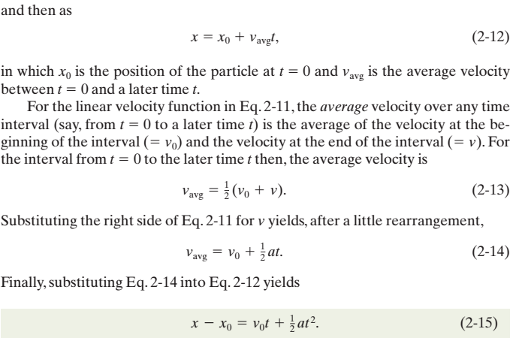

1-Dimensional Kinematics
Third Basic Equation

Slide 9
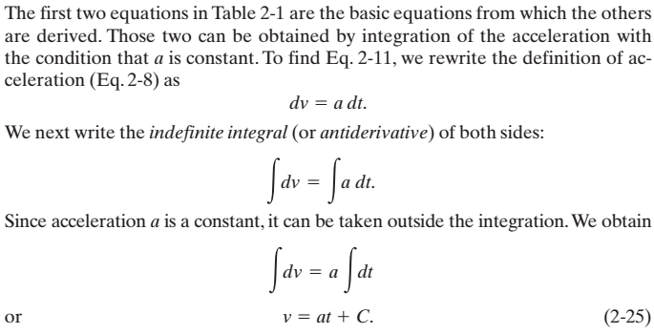
1-Dimensional Kinematics

Slide 10
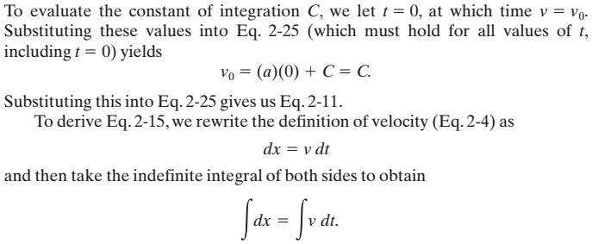
1-Dimensional Kinematics

Slide 11
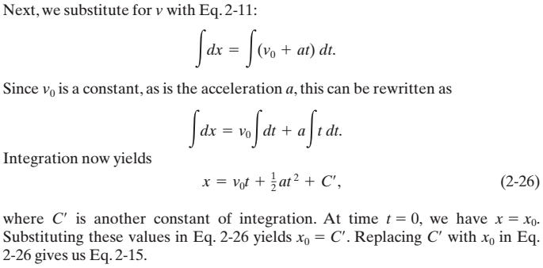
1-Dimensional Kinematics

Slide 12
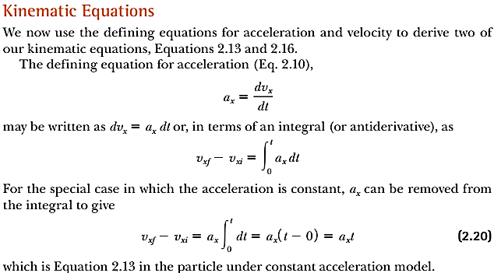
1-Dimensional Kinematics
For x-direction only

Slide 13
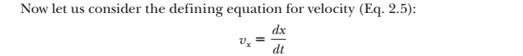
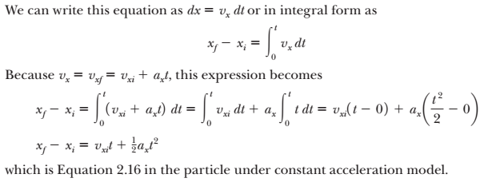
1-Dimensional Kinematics
For x-direction only

Slide 14
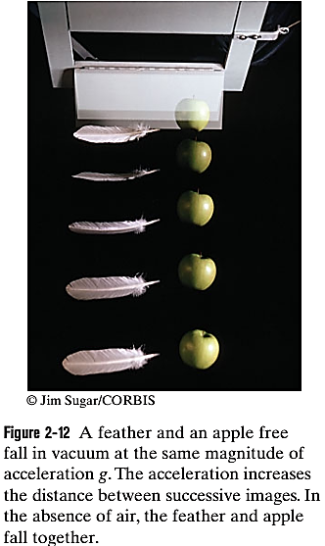

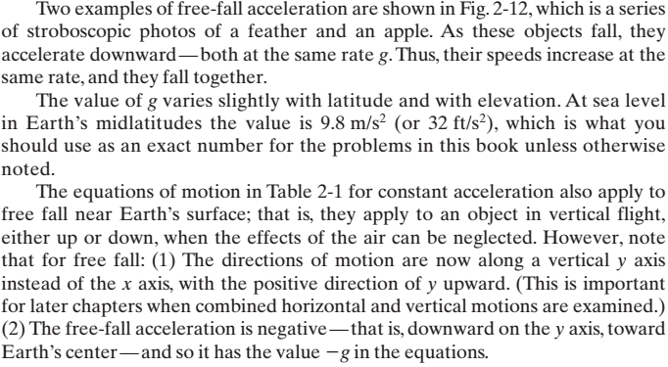

1-Dimensional Kinematics

Slide 15
